Slide 1

“Human Activity Recognition using Deep Learning Approach”
Submitted By
Pallab Majumdar | 18192103050
Al Ahad Sufian | 18192103056
Joy Adhikary | 18192103062
Mafuja Akter Mitu | 18192103068
Habibullah | 18192103080
Supervised By
Special Thanks To
M. M. Fazle Rabbi
Assistant Professor
Department of CSE
Md Saifur Rahman Assistant Professor & Chairman Department of CSE

Slide 2
Introduction
Improve accuracy by learning complex features from raw data on activity recognition.
Can process large amounts of data efficiently for real-time activity recognition.
Recognizing real-world behavior requires generalizing to new data.
Can recognize a wide range of human activities and behavior.
Can be performed using sensors embedded in smartphones, wearables, or other non-intrusive devices.
Can be automated, eliminating the need for manual annotation or labeling of data.

Slide 3
Objective
“To develop a deep learning-based model for recognizing human activities with high accuracy using video and sensor data.”

Slide 4
Literature Review
Limin Wang et al. [1] propose a novel architecture called Temporal Segment Networks (TSN) for video-based action recognition, which incorporates a segment-based sampling strategy to improve temporal modeling in deep neural networks. They used a 2D CNN, features extraction & standard stochastic gradient descent methods including the segment-based sampling strategy, the consensus function, and the use of multi-scale and multi-modal inputs, and show that TSNs achieved an accuracy of 94.5%. On Something-Something V1 and V2, TSNs also achieved an accuracy of 49.7% and 52.9%, respectively.
Sukrit Bhattacharya et al. [2 ] perform an analysis of human activity recognition based on the video that uses both spatial and temporal information from video frames to make predictions. They proposed a method, called SV-NET, using the VGG-16 network and 3D CNN. After training and testing the proposed model, they got an accuracy of 96.3% on UCF101, 75.3% on HMDB51, and 80.7% on Hollywood2.

Slide 5
Dataset
We use UFC 101 and Accelerometer datasets
The UFC 101 dataset consists of 101 video clips.
Each approximately 10 seconds in length.
The dataset is divided into three splits: 75:25 ratio, 70:30 ratio, and 80:20 ratio.
Each of which can be used to train action recognition models.
The WISDM (Wireless Sensor Data Mining) dataset contains 21330 instances of accelerometer data.

Slide 6
Dataset processing
Video Split
Label Encoding (one-hot)
Image Processing
Object Detection
Feature extraction
Image augmentation

Slide 7
Training Model 1
Convulational Neural Network (CNN)
Karnel = 2, Stride = 1,2
Layers:
2D convulation1
Max pooling1
2D convulation2
Max pooling2

Slide 8
Training Model 2
Convulational Neural Network - Long Short-Term Memory (CNN-LSTM)
Karnel = 2, Stride = 1,2, Validation = 0.3
Max sequence length = 20
Number of features = 2048
Activation = softmax
Layers:
2D convulation1
Max pooling1
2D convulation2
Max pooling2

Slide 9
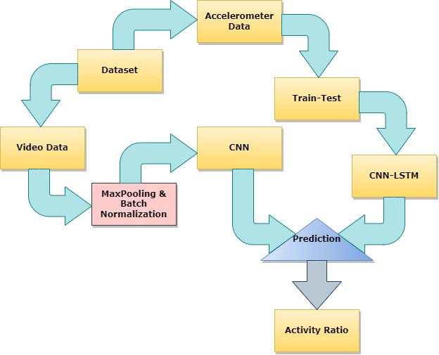
Proposed Methodology
Figure: Proposed CNN-LSTM architecture to recognize human activity

Slide 10
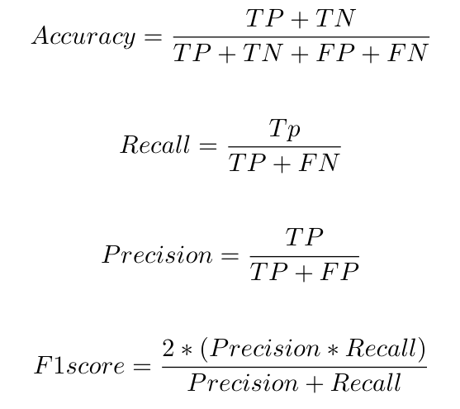
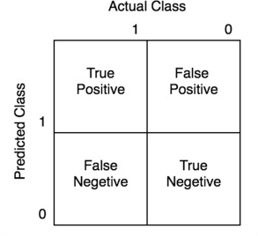
Evaluation Criteria

Slide 11
Accuracy
Models | Accuracy
CNN | 93.18%
CNN-LSTM | 75.34%
CNN-LSTM | 99.67%

Slide 12
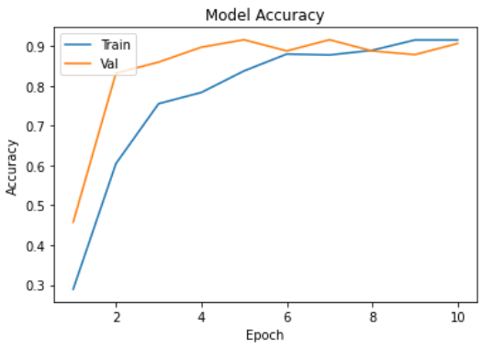
Results Based Data Visualization
Figure: Accuracy of the proposed model

Slide 13
Summary of the proposed model CNN-LSTM
Layer | Output Shape | Parameter
Input Layer | 79*2*16 | 80
Inception-ResNet-V2 | 78 * 1 * 32 | 2080
MaxPooling2D | 78 * 1 * 32 | 0
Dense | 64 | 159808
Dropout2 | 2*64 | 0
Reshape | 80*3 | 0
Flatten2 | 2496 | 0
Dense2 | 6 | 390
Sigmoid | 1 | 0
Table: Summary of the proposed model CNN-LSTM

Slide 14
Comparison of Proposed Methodology
Authors | Algorithms | Accuracy
Andrej et al. [3] | CNN | 65.5%
ShaHuan et al. [4] | CNN + CNN-LSTM | 96.9%
Zhu et al. [5] | CNN | 96.08%
K et al. [6] | CNN+RNN | 97.5%
Proposed | CNN + CNN-LSTM | 99.67%
Table: Performance comparison with the existing methods

Slide 15
Future Works
One of our goals going forward is to adding more datasets.
Another thing we could do in the future is look into new algorithms that could help us make our model better.
Adding support for real-time synchronization of our project is yet another area for development.
Keeping the validation process, improve the accuracy of the global model

Slide 16
References
[1] Limin Wang, Yuanjun Xiong, Zhe Wang, Yu Qiao, Dahua Lin, Xiaoou Tang, and Luc Van Gool. Temporal segment networks: Towards good practices for deep action recognition. In European conference on computer vision , pages 20–36. Springer, 2016
[2] Sukrit Bhattacharya, Vaibhav Shaw, Pawan Kumar Singh, Ram Sarkar, and Debotosh Bhattacharjee. Sv-net: A deep learning approach to video based human activity recognition. In Proceedings of the 11th International Conference on Soft Computing and Pattern Recognition (SoCPaR 2019) 11 , pages 10–20. Springer, 2021
[3] Andrej Karpathy, George Toderici, Sanketh Shetty, Thomas Leung, RahulSukthankar, and Li Fei-Fei. Large-scale video classification with convolu-tional neural networks. In Proceedings of the IEEE conference on Com-puter Vision and Pattern Recognition, pages 1725–1732, 2019.
[4] Sha Huan, Limei Wu, Man Zhang, Zhaoyue Wang, and Chao Yang. Radarhuman activity recognition with an attention-based deep learning network.Sensors, 23(6):3185, 2023.
[5] Fan Zhu, Ling Shao, Jin Xie, and Yi Fang. From handcrafted to learned representations for human action recognition: A survey. Image and Vision Computing , 55:42–52, 2020
[6] K Vijayaprabakaran, K Sathiyamurthy, and M Ponniamma. Video-based human activity recognition for elderly using convolutional neural network. International Journal of Security and Privacy in Pervasive Computing (IJSPPC), 12(1):36–48, 2020.

Slide 17
Thank You!

